Slide 1
Predicting Wine Quality
Thirumurugan Vinayagam
Mohammed Saqib
Shelby Watson
Amey Athaley
Daniel Oh
Notes:
Intro: Daniel

Slide 2
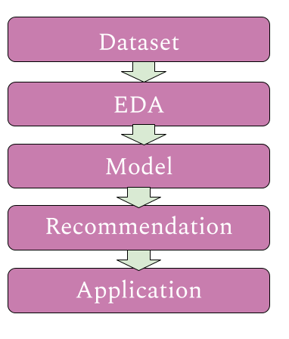
Our Process
Our problem and the dataset we used to form solutions
Exploratory Data Analysis and dataset observations
Trial of various supervised learning models and selection
Our model recommendation to best solve the problem
How our recommendations can be applied
Notes:
Daniel

Slide 3
What are we trying to predict?
Wine Quality
Ratings range from 3-9
Median of 6
Based on 12 predictors
Alcohol, density, pH, residual sugars, chlorides, citric acid, sulphates, free sulphur dioxide, total sulfur dioxide, volatile acidity
Dataset from UC Irvine Machine Learning Repository
Dataset
EDA
Model
Recommendation
Application
Notes:
Description of Dataset: Thiru
Dataset from UC Irvine Machine Learning Repository
The goal is to model wine quality based on physicochemical tests
Mean 5.818
acidity, sugar, sulfur dioxide, alcohol, wine type, chlorides, and density

Slide 4
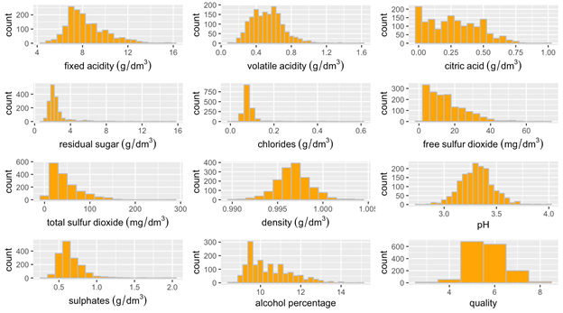
EDA
Dataset
EDA
Model
Recommendation
Application
Notes:
amey

Slide 5
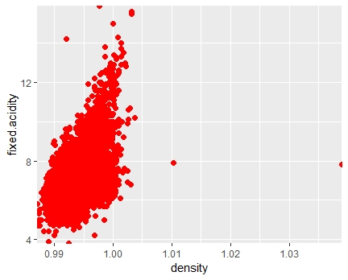
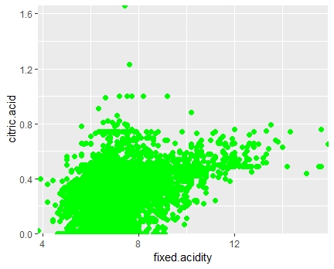
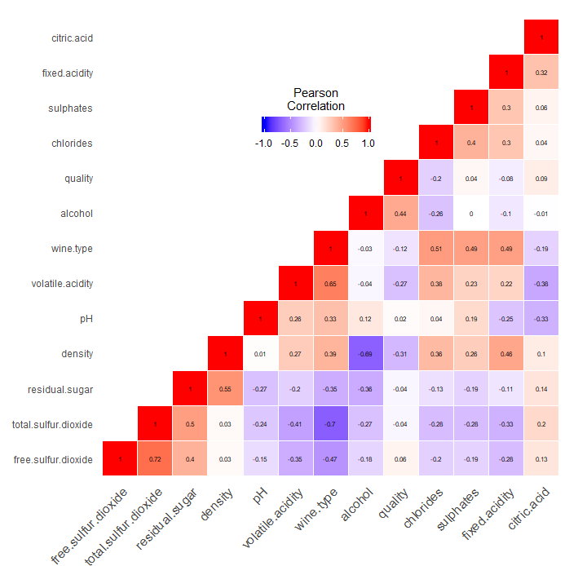
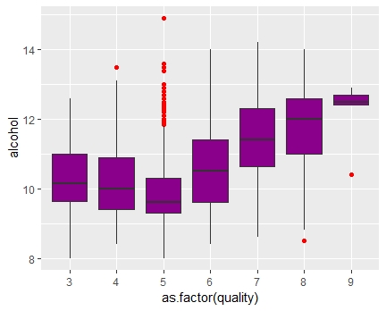
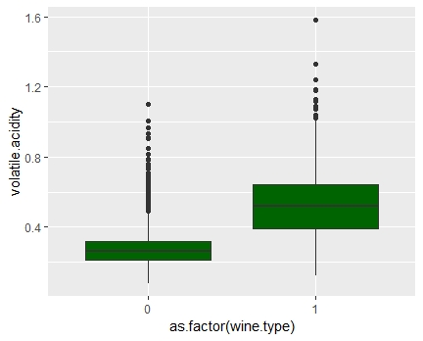
EDA
Dataset
EDA
Model
Recommendation
Application
Notes:
Amey

Slide 6
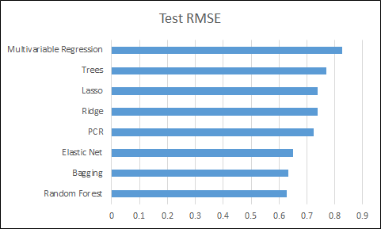
Model Results
Test RMSE:
Ridge: 0.737
Lasso: 0.738
Elastic Net: 0.649
Multi. Var Regression: 0.826
PCR: 0.723
Trees: 0.770
Bagging: 0.632
Random Forest: 0.623
Boosting: 0.699
Dataset
EDA
Model
Recommendation
Application
Notes:
Simple Linear Regression: Saqib
Multivariable: Thiru
Ridge Regression: Daniel
Lasso: Daniel
Tree: Amey
Bagging and Boosting: Shelby
Random Forest: Amey

Slide 7
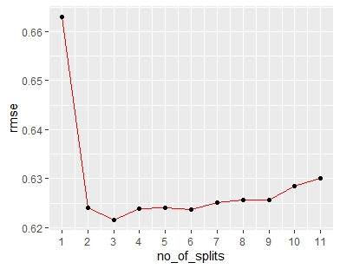
Model Recommendation
We recommend the Random Forest algorithm:
Lowest RMSE of 0.623 Quality Points
~46% Variance explained
Good model for subjective problem
Dataset
EDA
Model
Recommendation
Application
Notes:
Shelby

Slide 8
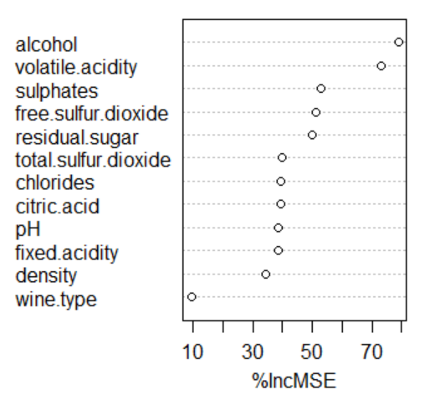
Our Recommendation
Which variables are the most important?
Alcohol Level
Volatile Acidity
Dataset
EDA
Model
Recommendation
Application
Notes:
Saqib

Slide 9
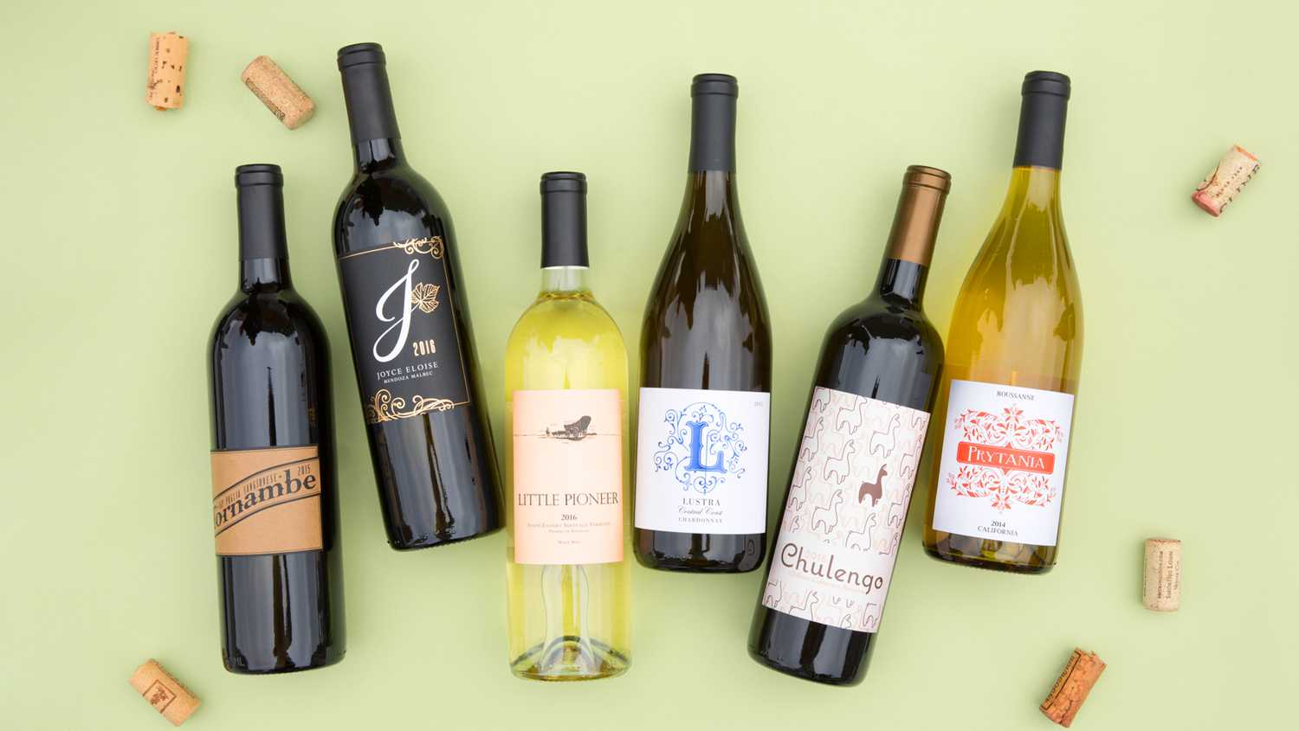
Application
Potential Clients
Online Wine Retailers
Grocery stores
Wineries
Restaurants
Dataset
EDA
Model
Recommendation
Application
Notes:
Thiru
Quiz
App

Slide 10
Questions?
Notes:
Thiru

